Slide 1
Project 3: Data Science Salaries

Slide 2
Overview
Aims:
Discover the best predictors of salary based on data science job postings
Apply model to project salaries for jobs with no salary listed
Dataset
Information drawn from indeed.com job postings
Salary Estimates, location, title, summary narrative
4000+ listings
Limitations:
Salary listings incomplete
Entry level only
Only certain cities: 50 mile radius

Slide 3
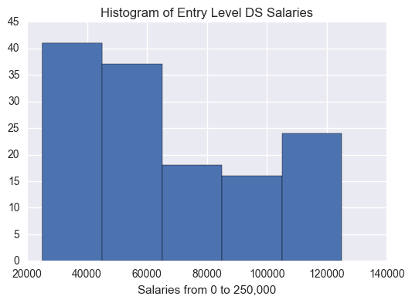
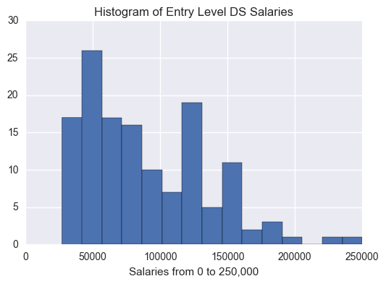
Distribution: Indeed Salaries vs. Listed Salaries
>> Despite scant data on salary from employers, the distribution of available data is similar in SHAPE to the predicted salaries generated by indeed.com, but not in RANGE
>> Either indeed underestimates salaries, or employers that provide information about salary tend to be those offering more competitive compensation
Notes:
Do the distributions look normal?
Bin sizes 10

Slide 4
Models and features:
Models
Random Forest Classifier
Support Vector Machine (rfb kernel)
Random Forest Regressor
AdaBoost Classifier (with Random Forest as base estimator)
Features used in models
Location (using binary features, first dropped)
Job title (Tfidf vectorized)
Job summary text (Tfidf vectorized)
Company name (Tfidf vectorized)
Combined title, summary and company name (Tfidf vectorized)

Slide 5
Results: (baseline = .47)
Random forest models are the most predictive
Especially RFM with only ‘job title’ and AdaBoost RFM with all text features (title, summary, company name)
RFMs had Accuracy, Precision, Recall and H1 scores ranging from roughly .65 to nearly .9

Slide 6
Results: (baseline = .47)
SVC and RFM regressions did not perform well:
SVC had accuracy below baseline .43
RFM Regression model based on ‘job summary’ text received an r score of .09
RFM Regression model based on ‘job summary’ text received a decent r score .64

Slide 7
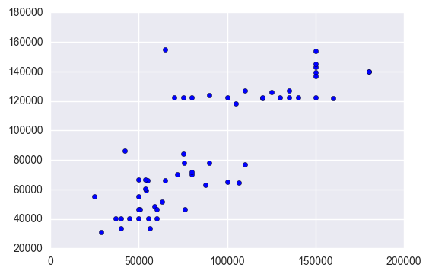
RFM (features from ’title’ text) Actual vs Predicted Salary

